Slide 1
Coach Notes
The lesson has a lot to cover but it will be fun once it is finished.
Possibly provide some code to the students that may take awhile to type like the filter list to reduce the workload of the students and provide them enough time to play with the camera.

Slide 2
Machine Learning With Raspberry Pi Camera
AI Code Academy

Slide 3
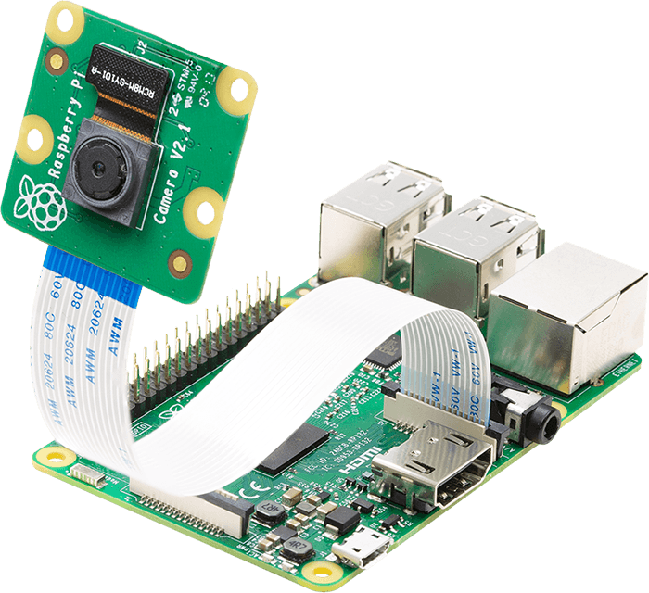
Materials Needed
For this lesson, we’ll need the following materials:
Raspberry Pi with SSH and VNC connection
Breadboard
Pi Camera
4 Push Buttons
5 Resistors
LED
Wires As Appropriate

Slide 4
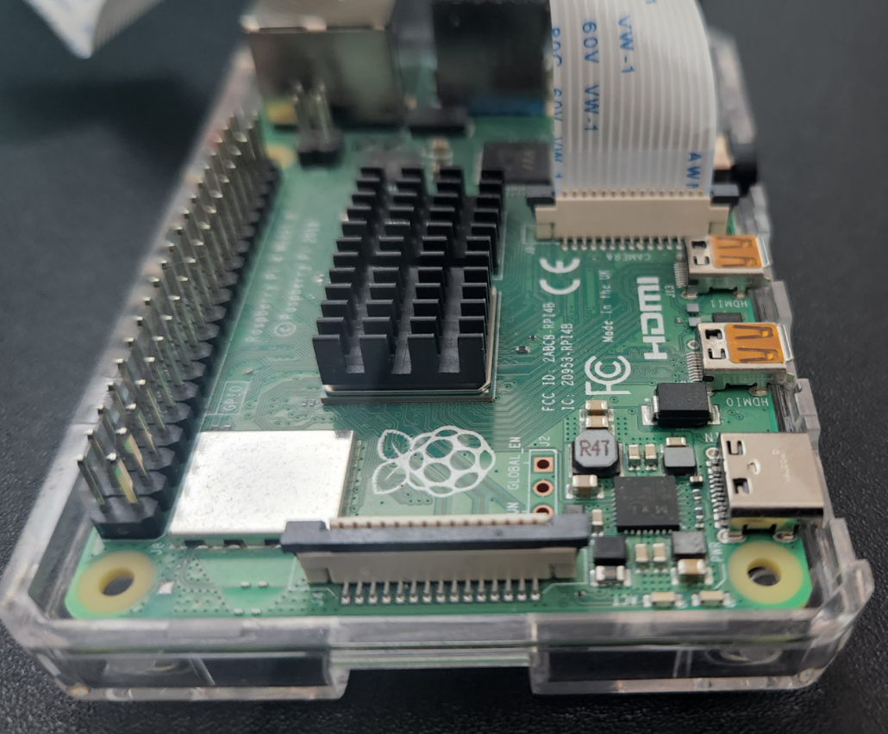
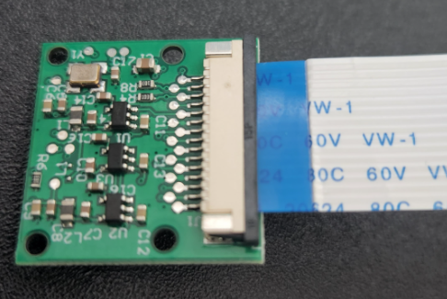
Camera Installation
Depending on the camera you buy, the ribbon cable may look different.
Generally you need to connect the ribbon cable such that the contacts on the Pi and Camera touch the contacts on the cable.
See the images to the right for orientation of the camera.

Slide 5
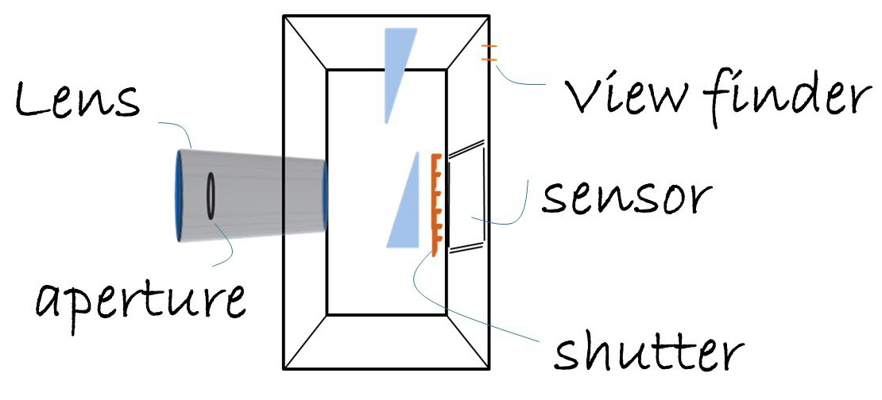
How Do Camera’s Take Pictures
The camera’s lens collects and focuses the light, and the sensor module is divided into millions of red, green, and blue pixels.
When light hits the pixel, the sensor converts it into energy and the amount measured is used to determine how much of the color is in the image.
A computer in the camera is used to estimate the colors in the scene and combines the pixels to create a complete picture

Slide 6
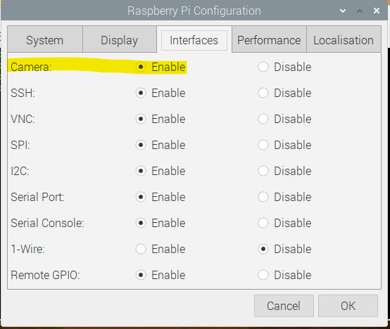
Enabling The Camera
Before we can use the camera, we must enable it.
Go to the Raspberry Pi Configuration and select enable for the camera.
Your Pi will reboot after you press ok.

Slide 7
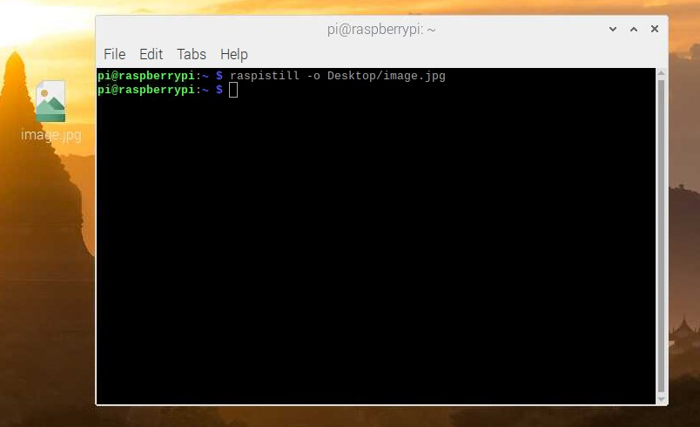
Taking A Picture Via Terminal
The rapistill command will take a picture using the camera.
The command raspistill –o Desktop/image.jpg will create a picture titled image and save it to the desktop.
Open the file after you run this command.
You can modify the command to change the size of the image by using: raspistill -o Desktop/image-small.jpg -w 640 -h 480

Slide 8
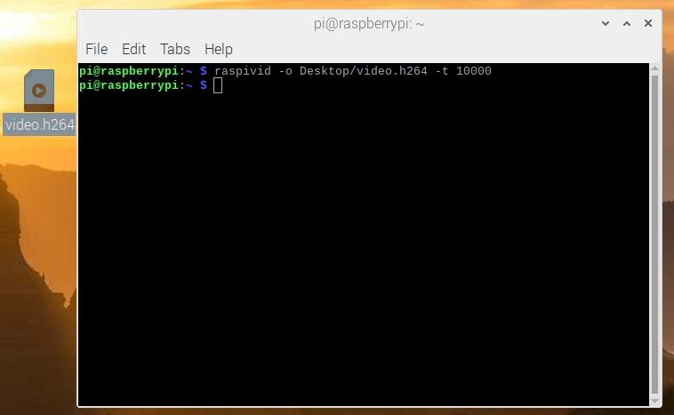
Recording A Video Via Terminal
To record a video in the terminal, we will use the raspivid command.
To record a video, enter raspivid -o Desktop/video.h264 -t 10000
The video is in the h264 video format, and the t argument will set the length of the video in miliseconds.
Play your video after you record it.

Slide 9
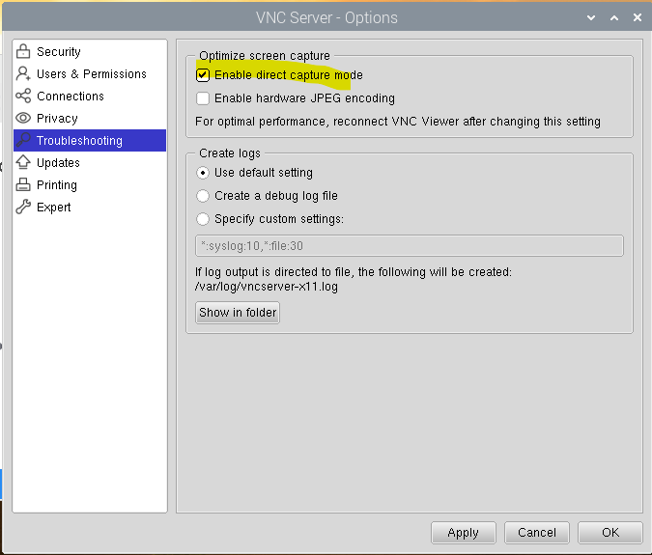
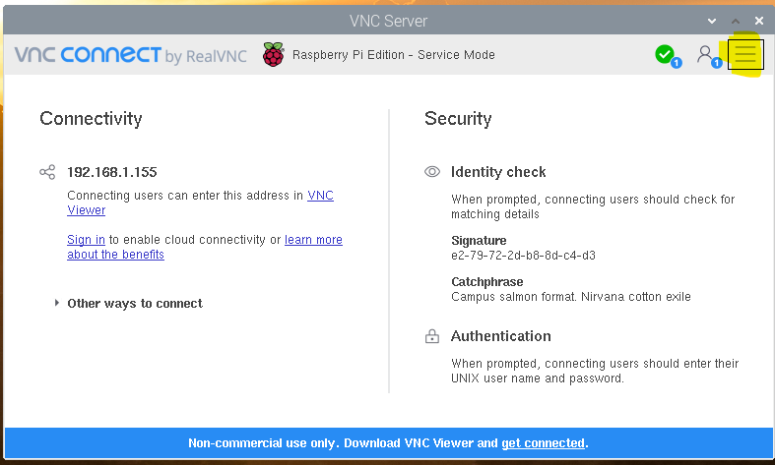
Enable Direct Capture
For us to see a live preview of our camera using VNC, we must enable direct capture.
Please go to VNC settings and then to troubleshooting.
Click on enable direct capture.

Slide 10
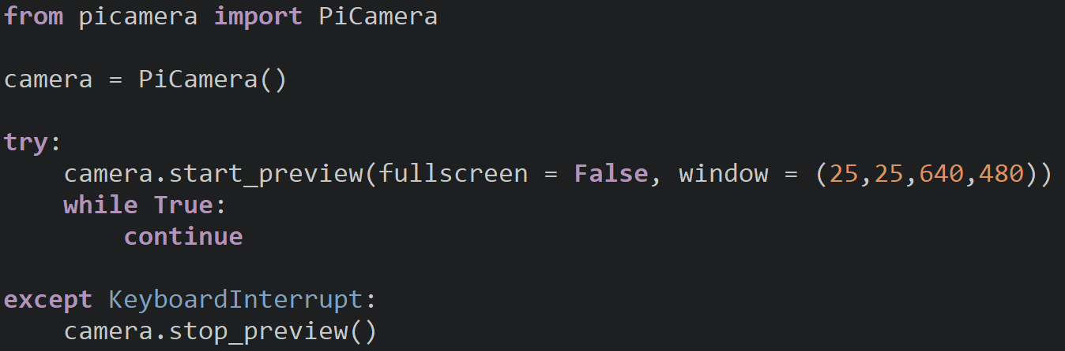
Creating A Live Preview
Using the PiCamera class, we can create a live preview of the camera. We need to create an instance of the camera and save it into a variable.
Create the preview using start_preview() and set fullscreen to False. We will set the window parameter (x,y,width, height) so that it does not fill the entire screen.
We will start the preview in a try and stop it when the Keyboard Interrupt occurs.
The while True loop will make sure the preview is open until we cause an exception.

Slide 11
Camera Control Board
We are going to create a camera control board that will take pictures, apply filters, and start and record video when buttons are pressed.
We will use interrupts to trigger these events and changes and turn on an LED to indicate that we are recording.

Slide 12
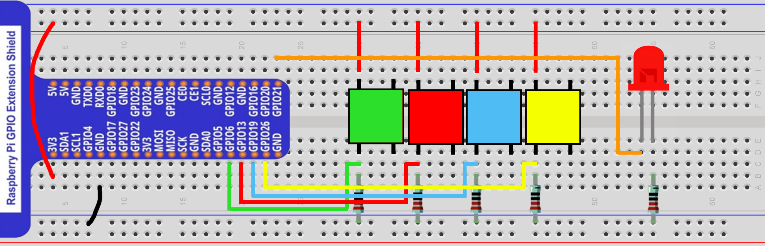
Project Circuit
4 Buttons, each connected to GPIO 6 – GPIO 26
LED connected to GPIO 21

Slide 13
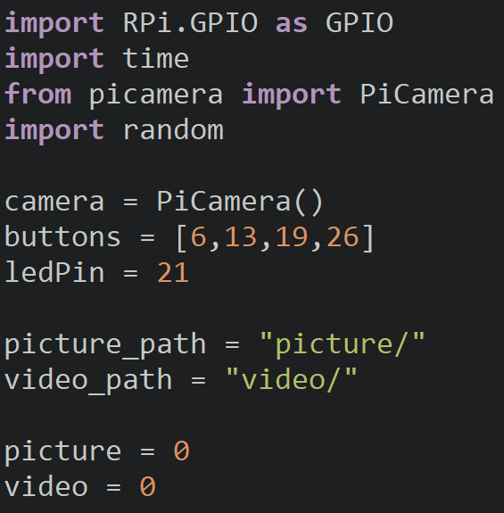
Setup
Import the appropriate modules and create a camera object.
Create variables to store the pin numbers and the paths of the picture and video folders.
Make sure these folders exist before your run your program.
The picture and video variables keep track of how many pictures and videos we have made since the file names will be numbered.

Slide 14
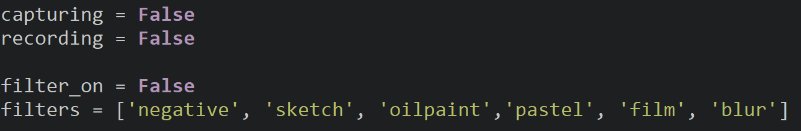
Setup
The variables capturing and recording make sure we don’t start recording while we have a video recording, and we only take one picture at a time.
The filters variable will store all the possible filters we can use, feel free to add or remove some. On the PI site they have more filters to choose from.
Notes:
https://projects.raspberrypi.org/en/projects/getting-started-with-picamera/7

Slide 15
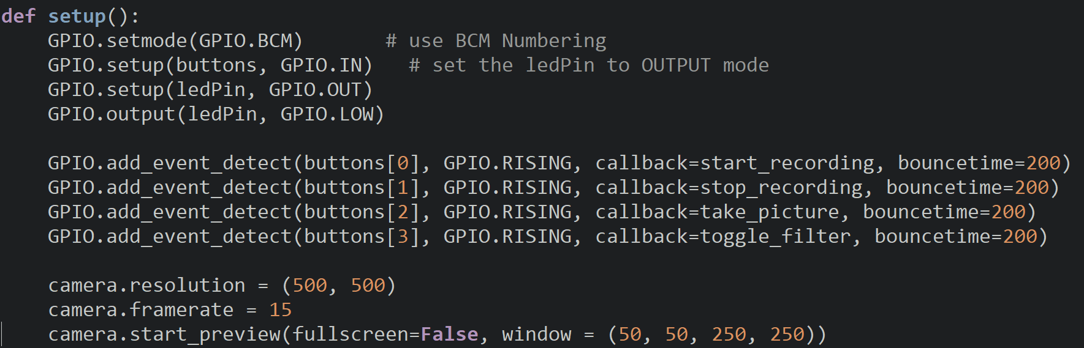
Setup
Inside the setup function, setup the pins as appropriate and add interrupts for each button with their appropriate function.
Adjust the resolution and framerate of the camera and start the preview window.

Slide 16
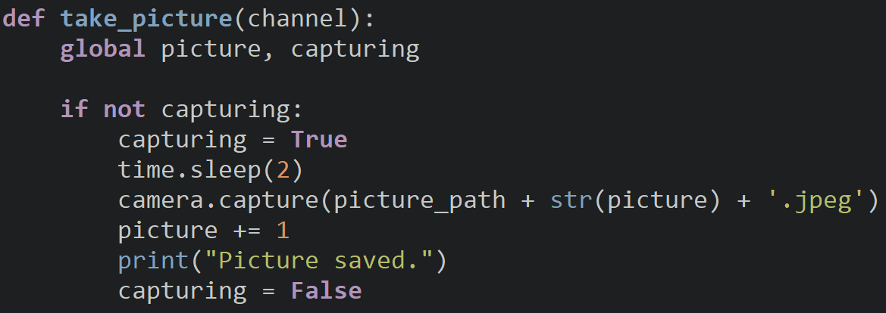
Taking Pictures
The take_picture function is called when the interrupt is triggered and will take a picture if we are not already taking one. A delay is used before we take the picture so that the camera has captured enough light.
Inside the if statement, increment the number of pictures taken and handle the capturing variable so it is set to True at the beginning and set to False once the picture is saved.

Slide 17
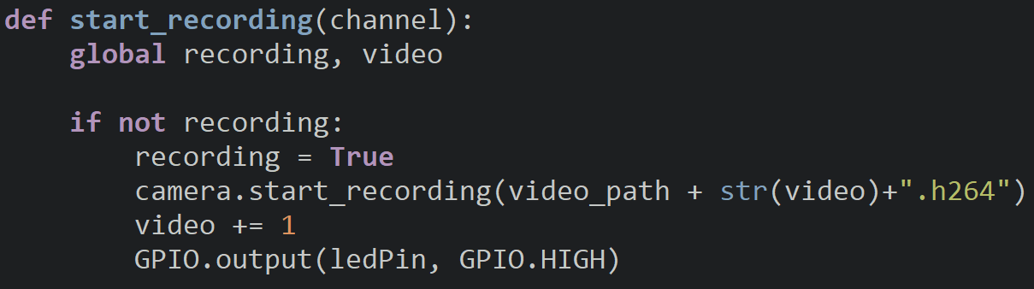
Start A Recording
The start_recording function starts a recording if one has not started.
Increment the number of videos recorded and turn on the LED after we start the recording to signify to the user that a recording is in progress.

Slide 18
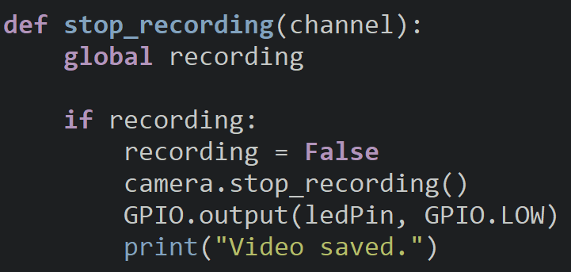
Stop A Recording
The stop_recording function will stop the recording if there is a recording in progress.
After the camera finishes recording, print a message saying the video was saved and turn off the LED.

Slide 19
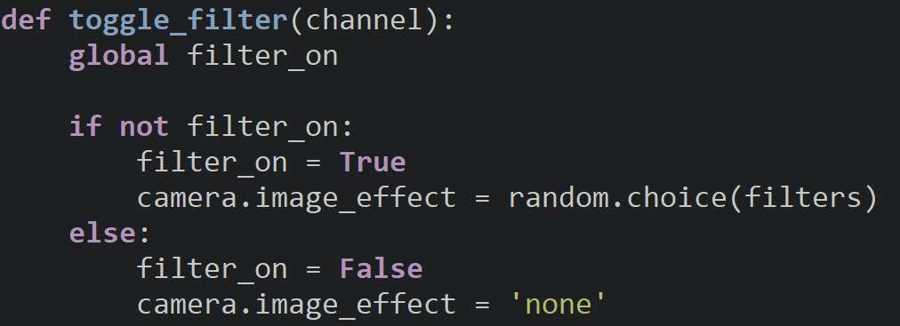
Applying A Filter
When we turn a filter on, set filter_on to True and set the image_effect property to a random filter.
When we turn the filter off, set the effect to ‘none’ and set filter_on to False

Slide 20
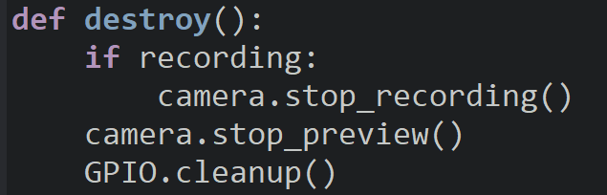
Destroy
Inside the destroy function we will check if we are recording and if so, stop the recording.
We will then stop the camera preview and then release the GPIO pins.

Slide 21
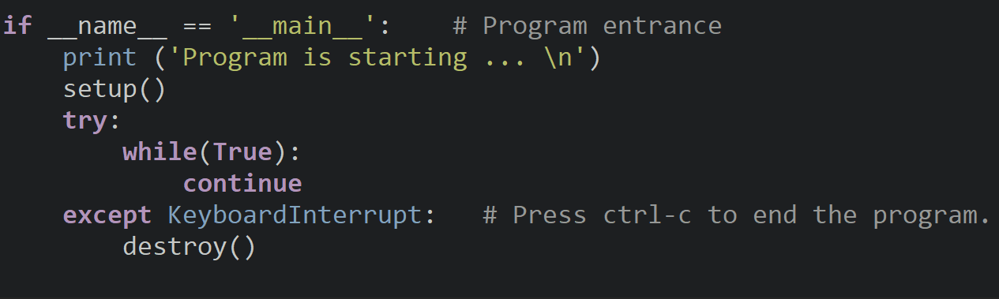
Program Entrance
We don’t have a loop for this project, so add a while true loop where the loop function call would normally go.

Slide 22
Discussion
Were you able to see the pictures you took and the videos you recorded?
What other features would you want to add this camera control board?
There are many other cosmetic features for the camera we were unable to cover. Take the time to look at the documentation.
Notes:
https://projects.raspberrypi.org/en/projects/getting-started-with-picamera/7

Slide 23
Power off
As usual, shut down your pi properly before disconnecting power.

